Slide 1

G2M Case Study
Data Science Virtual Internship
Submitted by: Pinakin Prabhakar

Slide 2
Problem Statement
XYZ is a private investment firm in USA, who wants to step into Cab Industry as in last few years it has shown remarkable growth in it.
Objective : Provide actionable insights to help XYZ firm in identifying the right company for making investment.
The analysis has been divided into four parts:
Data Understanding and Visualization
Multiple Hypothesis and Investigate
Finding the most users Cab company
Finding the most economical Cab company for users.
Finding most profitable Cab company for XYZ.

Slide 3
Approach
Dataset was taken from github.
Cleaned the Dataset and checked their types.
Found the relationship between each tables and each table was linked with primary and foreign key.

Slide 4
Data Exploration
Cab_Data.csv :- This table contains the information about Yellow and Pink Cab company and their transactions.
Customer_ID.csv :- This table contains the information about the customers like their Income, Age and Gender
Transaction_ID.csv :- This table contains the information about which customer has used what payment method.
City.csv :- This table contains the list of USA cities, their populations and the number of cab users.
Timeframe of the data :- 2016-01-31 to 2018-12-31
Total data points :- 355,032

Slide 5
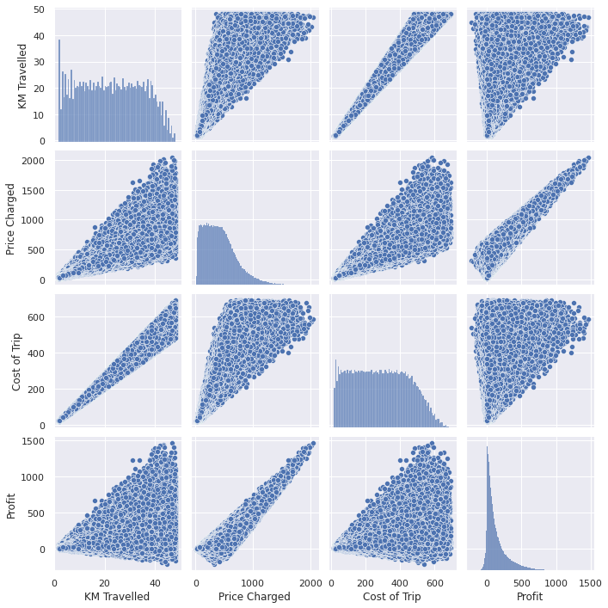
Relationships Between Variables

Slide 6
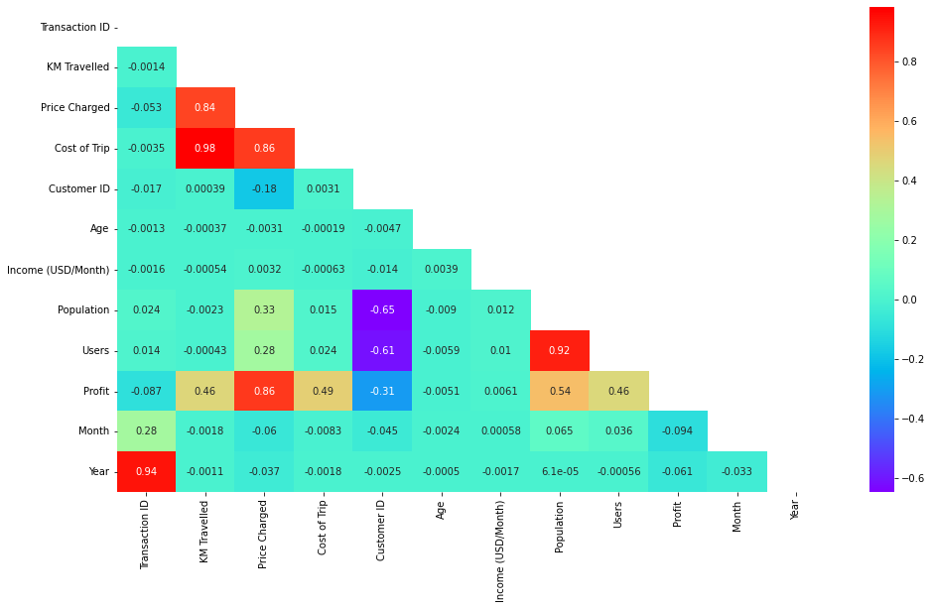
Correlation Between Variables
We can notice strong relation between :
Price Charged to the Cost of Trip
Kms Travelled to the Cost of Trip
Population to the Users

Slide 7
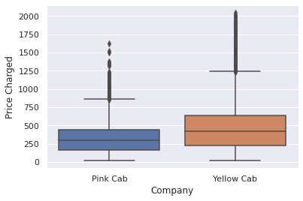
Average Price Charged
Here we can observe that average price charged by Yellow cab is more than Pink cab.

Slide 8
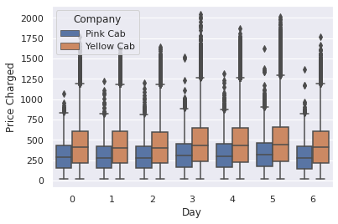
Average Price Charged Analysis across Week
We can observe that both Cab companies has charged users most on last Thursday , Friday and Saturday.
We can infer that users like to use cabs more in weekends compared to weekdays.

Slide 9
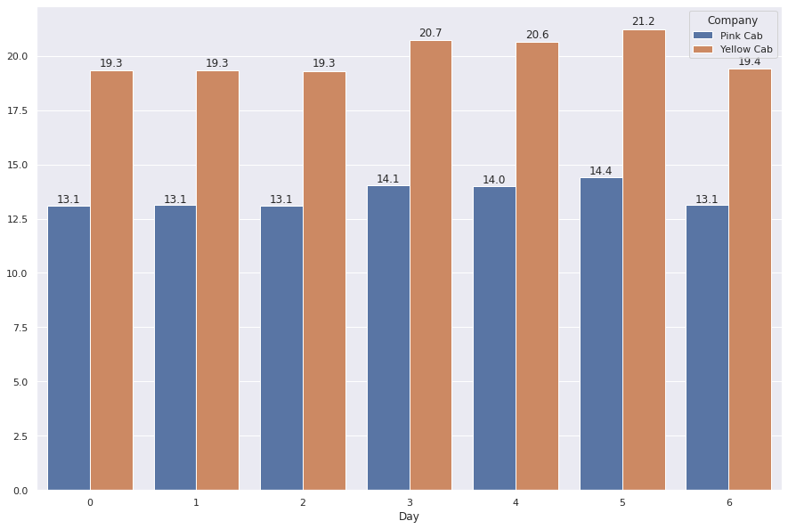
Average Price Charged per Kms across Week
We can observe that companies has surged their charges on Weekends as they observe more users to attend more profit.

Slide 10
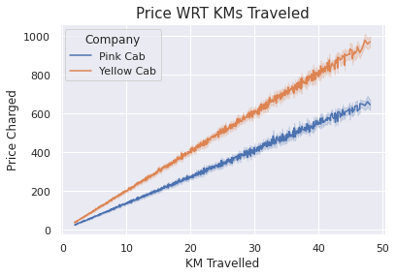
Relation Between Price Charged w.r.t KMS
We can notice there is as Linear Relationships between the Price Charged and the KMs Travelled by the user in the cab.

Slide 11
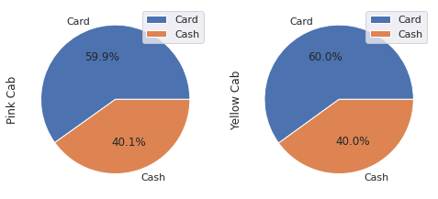
Payment Method Preference
We can notice that for both companies users prefer Card for transactions compared to the Cash.

Slide 12
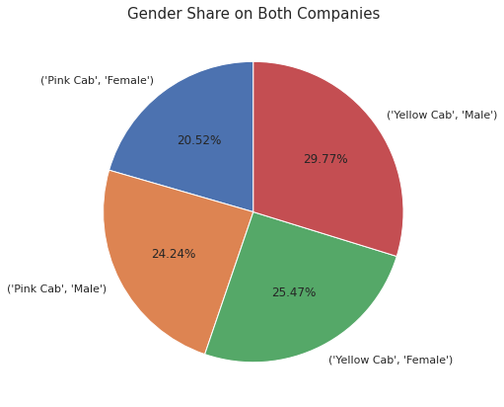
Users w.r.t Gender
There are more Male users Compared to Female.
Both Male and Female prefer Yellow Cab more over Pink Cab.

Slide 13
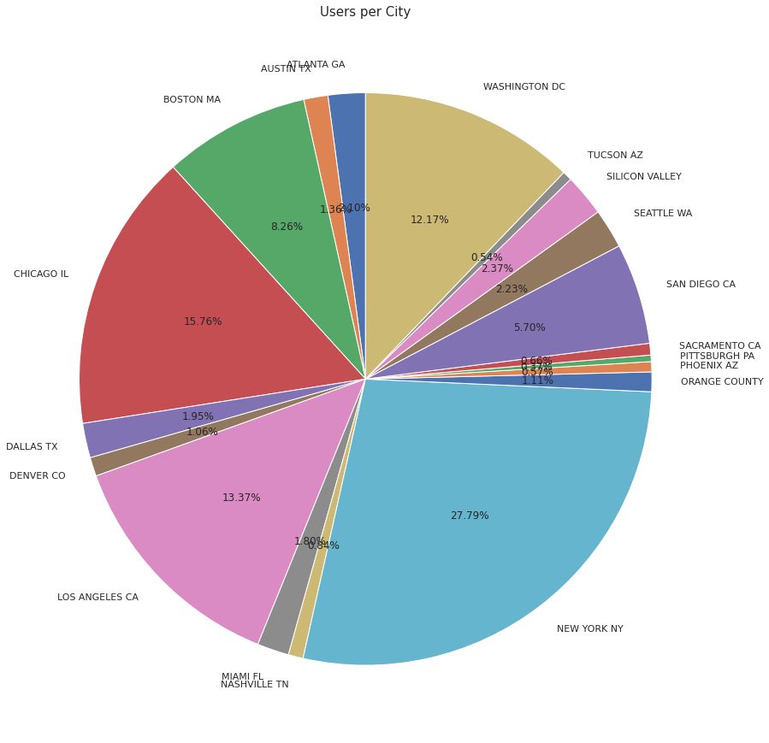
Users w.r.t City
New York has almost more that one forth Cab users across the total number of Cab users and Pittsburgh has the least number of users.

Slide 14
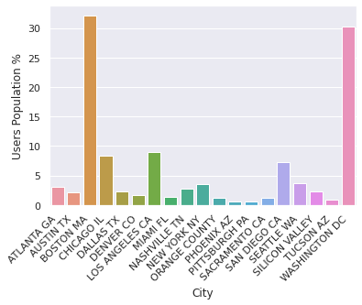
Users w.r.t Population
We can notice that in Boston and Washington more than 30% of their population uses cab service.

Slide 15
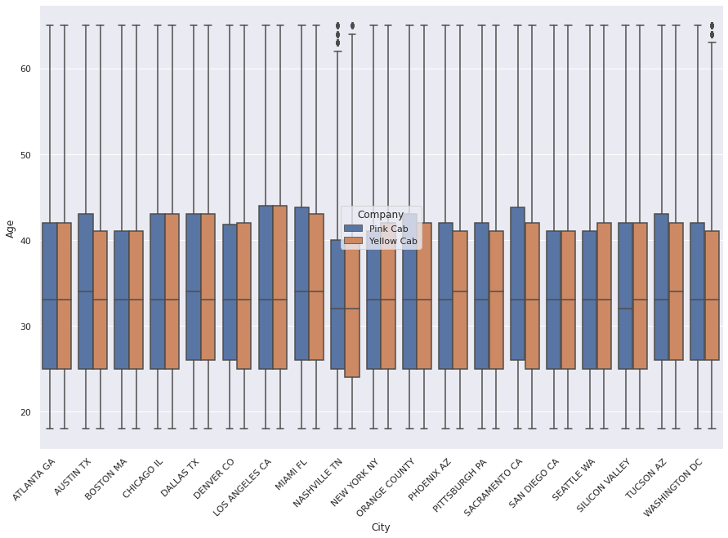
Average age of Users w.r.t Cities
We can notice that average age of the user that uses Cab service in all of the cities are in between their 30’s and 40’s .

Slide 16
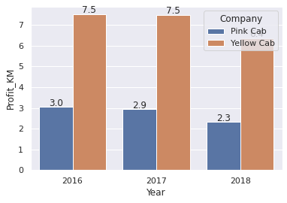
Profit Analysis
Profit Analysis
We can notice that Yellow cab has more profit per km than Pink Cab, but for both companies it has decreased gradually across the years.

Slide 17
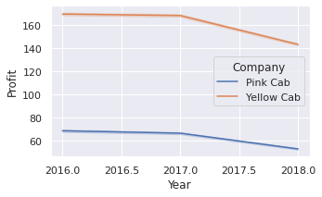
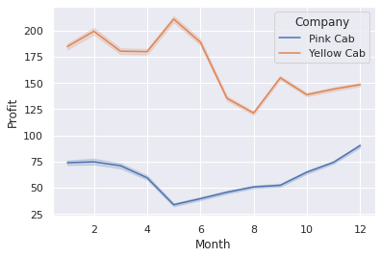
Profit Analysis
Profit Analysis
We can comment that for both companies profit has decreased w.r.t years.
Profit margin changes w.r.t month.

Slide 18
Recommendations
After conducting a thorough analysis of both companies, it is my recommendation that XYZ Company invests in Yellow Cab rather than Pink Cab. Our data indicates that Yellow Cab has stronger financial performance, a more favorable market position, and greater potential for growth. However, I advise further due diligence and analysis to confirm our recommendation.
Offering incentives and deals for users who choose to pay with a card could be a strategic move to increase customer engagement and attract more users to the company. Some potential incentives could include discounts on purchases, special promotions, or rewards for frequent usage. Implementing such a program could also provide valuable data for the company to better understand consumer behavior and payment preferences. This approach aligns with the goal of providing a positive customer experience and incentivizing them to choose the company for their purchases.
On the basis of above point , we will recommend Yellow cab for investment.

Slide 19
Thank You

